Slide 1
Monitoring and Evaluation of Health Services
EHS 215

Slide 2
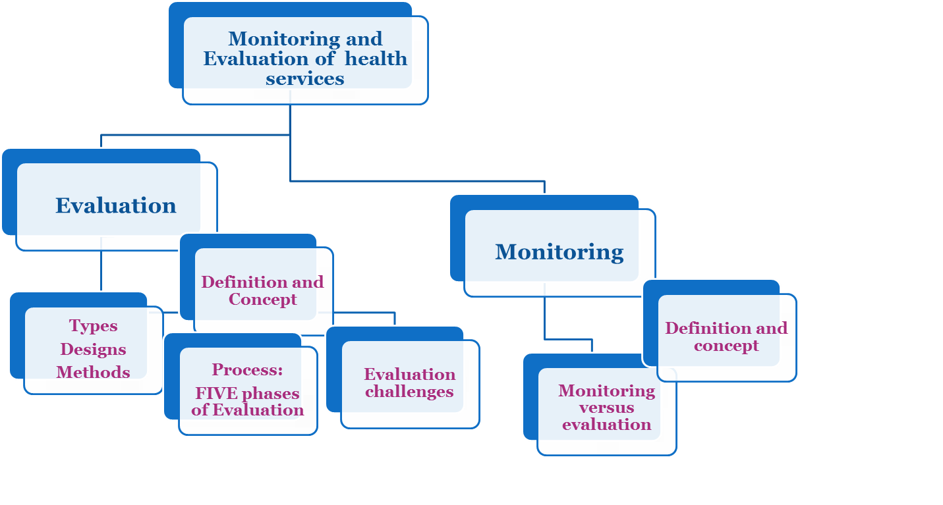
Presentation Outline

Slide 3
Monitoring and Evaluation (M&E)
Monitoring progress and evaluating results are key functions to improve the performance of those responsible for implementing health services.
M&E show whether a service/program is accomplishing its goals. It identifies program weaknesses and strengths, areas of the program that need revision, and areas of the program that meet or exceed expectations.
To do this, analysis of any or all of a program’s domains is required

Slide 4
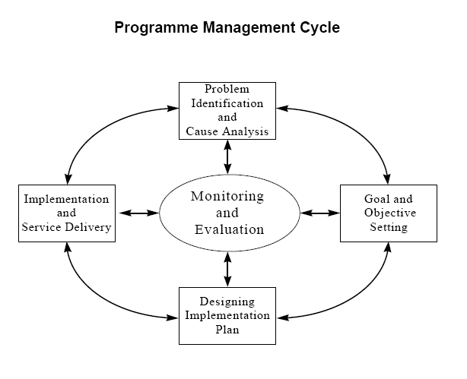
Where does M&E fit?

Slide 5
Monitoring versus Evaluation
Monitoring
Evaluation
A planned, systematic process of observation that closely follows a course of activities, and compares what is happening with what is expected to happen
A process that assesses an achievement against preset criteria.
Has a variety of purposes, and follow distinct methodologies (process, outcome, performance, etc).

Slide 6
Evaluation
Monitoring
A systematic process to determine the extent to which service needs and results have been or are being achieved and analyse the reasons for any discrepancy.
Attempts to measure service’s relevance, efficiency and effectiveness. It measures whether and to what extent the programme’s inputs and services are improving the quality of people’s lives.
The periodic collection and review of information on programme implementation, coverage and use for comparison with implementation plans.
Open to modifying original plans during implementation
Identifies shortcomings before it is too late.
Provides elements of analysis as to why progress fell short of expectations

Slide 7
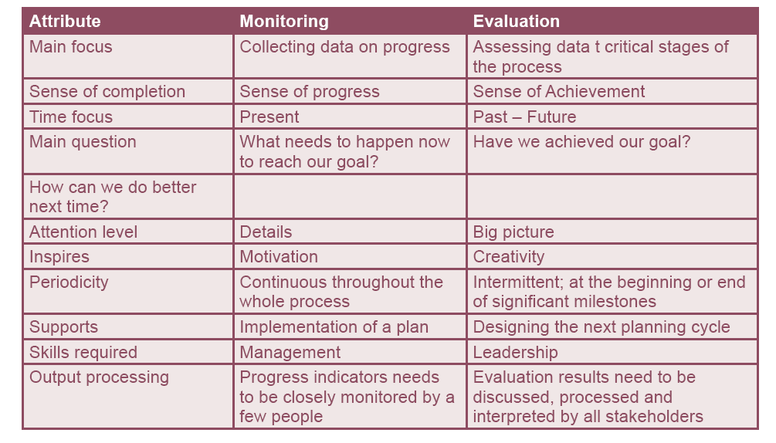
Comparison between Monitoring and Evaluation

Slide 8

Evaluation

Slide 9
Evaluation can focus on:
Projects
  normally consist of a set of activities undertaken to achieve specific objectives within a given budget and time period.
Programs
  are organized sets of projects or services concerned with a particular sector or geographic region
Services
  are based on a permanent structure, and, have the goal of becoming, national in coverage, e.g. Health services, whereas programmes are usually limited in time or area.
Processes
  are organizational operations of a continuous and supporting nature (e.g. personnel procedures, administrative support for projects, distribution systems, information systems, management operations).
Conditions
  are particular characteristics or states of being of persons or things (e.g. disease, nutritional status, literacy, income level).
Processes
Services
Projects
Conditions
Programs

Slide 10
Evaluation may focus on different aspects of a service or program:
Inputs
  are resources provided for an activity, and include cash, supplies, personnel, equipment and training.
Processes
  transform inputs into outputs.
Outputs
  are the specific products or services, that an activity is expected to deliver as a result of receiving the inputs.
A service is effective if
  it “works”, i.e. it delivers outputs in accordance with its objectives.
A service is efficient or cost-effective if
  effectiveness is achieved at the lowest practical cost.
Outcomes
  refer to peoples’ responses to a programme and how they are doing things differently as a result of it. They are short-term effects related to objectives.
Impacts
  are the effects of the service on the people and their surroundings. These may be economic, social, organizational, health, environmental, or other intended or unintended results of the programme. Impacts are long-term effects.
Processes
Inputs
Impacts
Outputs
Efficiency
Effectiveness
Outcomes

Slide 11


Slide 12

When Is Evaluation Desirable?
Program evaluation is often used when programs have been functioning for some time. This is called Retrospective Evaluation.
However, evaluation should also be conducted when a new program within a service is being introduced. These are called Prospective Evaluations.
A prospective evaluation identifies ways to increase the impact of a program on clients; it examines and describes a program’s attributes; and, it identifies how to improve delivery mechanisms to be more effective.

Slide 13
Prospective versus Retrospective Evaluation
Prospective Evaluation, determines
what ought to happen (and why)
Retrospective Evaluation, determines what actually happened (and why)

Slide 14
Evaluation Matrix
The broadest and most common classification of evaluation identifies two kinds of evaluation:
Formative evaluation.
  Evaluation of components and activities of a program other than their outcomes. (Structure and Process Evaluation)
Summative evaluation.
  Evaluation of the degree to which a program has achieved its desired outcomes, and the degree to which any other outcomes (positive or negative) have resulted from the program.

Slide 15
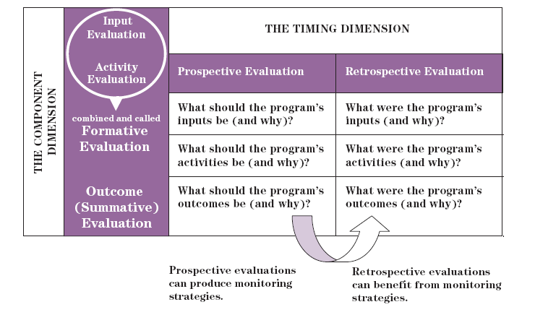
Evaluation Matrix

Slide 16
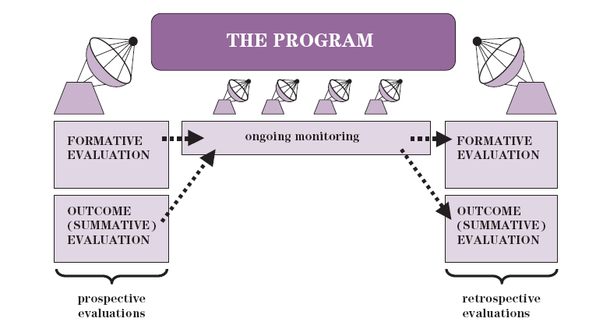
Components of Comprehensive Evaluation

Slide 17
Evaluation Designs
Ongoing service/program evaluation
End of program evaluation
Impact evaluation
Spot check evaluation
Desk evaluation

Slide 18
Who conducts evaluation?
Internal evaluation (self evaluation), in which people within a program sponsor, conduct and control the evaluation.
External evaluation, in which someone from beyond the program acts as the evaluator and controls the evaluation.

Slide 19
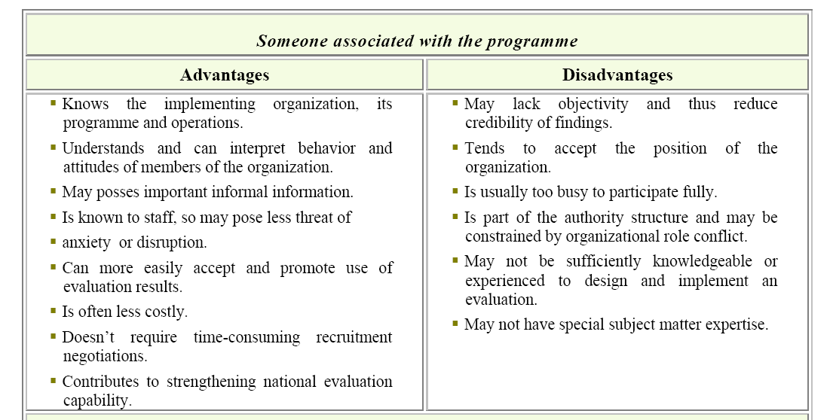
Tradeoffs between External and Internal Evaluation

Slide 20
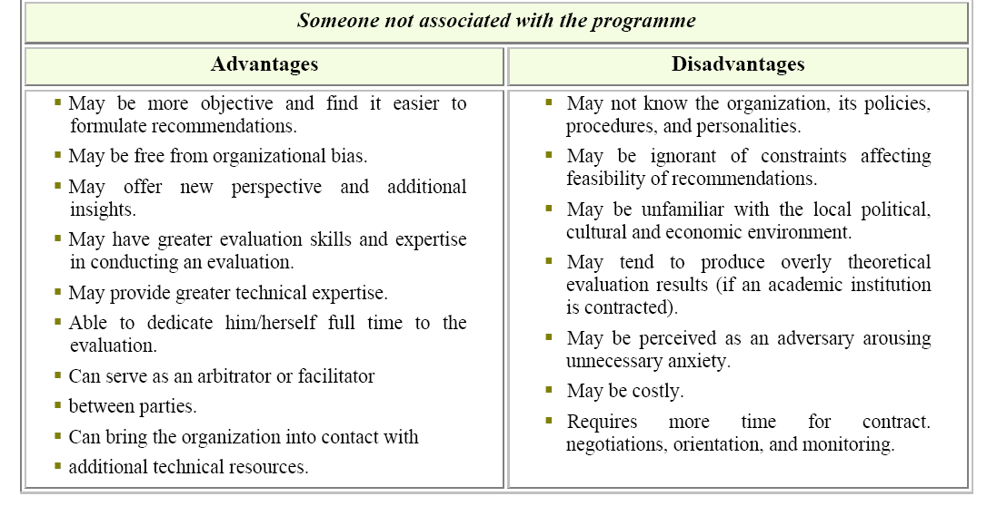
Tradeoffs between External and Internal Evaluation
Source: Adapted from UNICEF Guide for Monitoring and Evaluation, 1991.

Slide 21
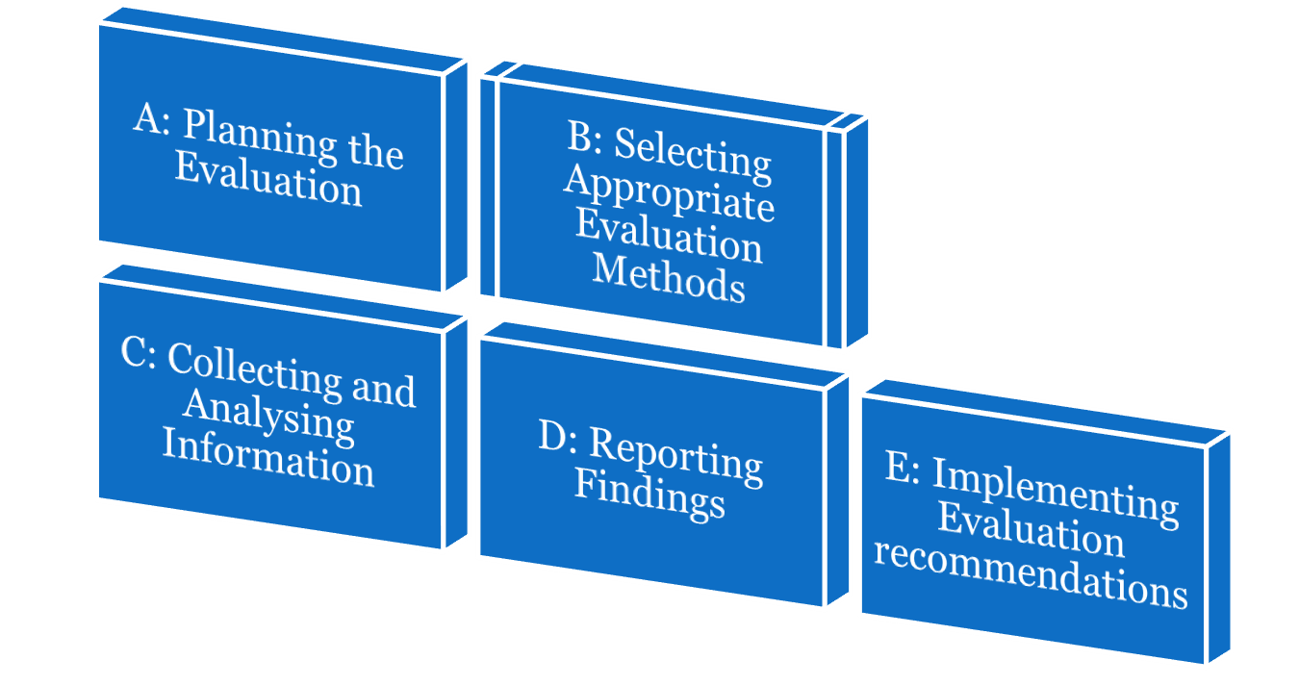
Guidelines for Evaluation (FIVE phases)

Slide 22
Phase A: Planning the Evaluation
*Provide background information on the history and current status of the programme being evaluated including:
How it works: its objectives, strategies and management process)
Policy environment
Economic and financial feasibility
Institutional capacity
Socio-cultural aspects
Participation and ownership
Environment
Technology
Determine the purpose of the evaluation.
Decide on type of evaluation.
Decide on who conducts evaluation (evaluation team)
Review existing information in programme documents including monitoring information.
List the relevant information sources
Describe the programme. *
Assess your own strengths and limitations.

Slide 23
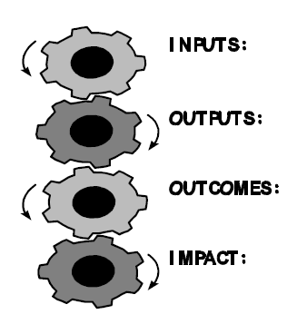
Phase B:Selecting Appropriate Evaluation Methods
Identify evaluation goals and objectives. (SMARTER)
Formulate evaluation questions and sub-questions
Decide on the appropriate evaluation design
Identify measurement standards
Identify measurement indicators
Develop an evaluation schedule
Develop a budget for the evaluation.

Slide 24
Sample evaluation questions: What might stakeholders want to know?
Program clients:
Does this program provide us with high quality service?
Are some clients provided with better services than other clients? If so, why?
Program Staff:
Does this program provide our clients with high quality service?
Should staff make any changes in how they perform their work, as individuals and as a team, to improve program processes and outcomes?
Program managers:
Does this program provide our clients with high quality service?
Are there ways managers can improve or change their activities, to improve program processes and outcomes?
Funding bodies:
Does this program provide its clients with high quality service?
Is the program cost-effective?
Should we make changes in how we fund this program or in the level of funding to the program?

Slide 25

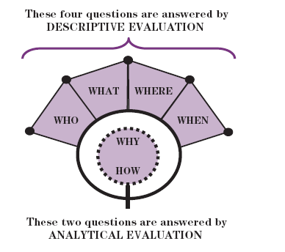

Slide 26
Indicators..... What are they?
An indicator is a standardized, objective measure that allows—
A comparison among health facilities
A comparison among countries
A comparison between different time periods
A measure of the progress toward achieving program goals

Slide 27
Characteristics of Indicators
Clarity: easily understandable by everybody
Useful: represent all the important dimensions of performance
Measurable
  Quantitative: rates, proportions, percentage, common denominator (e.g., population)
  Qualitative: “yes” or “no”
Reliability: can be collected consistently by different data collectors
Validity: measure what we mean to measure

Slide 28
Which Indicators?
The following questions can help determine measurable indicators:
  How will I know if an objective has been accomplished?
  What would be considered effective?
  What would be a success?
  What change is expected?

Slide 29
Evaluation Area (Formative assessment ) | Evaluation Question | Examples of Specific Measurable Indicators
Staff Supply | Is staff supply sufficient? | Staff-to-client ratios
Service Utilization | What are the program’s usage levels? | Percentage of utilization
Accessibility of Services | How do members of the target population perceive service availability? | Percentage of target population who are aware of the program in their area • Percentage of the “aware” target population who know how to access the service
Client Satisfaction | How satisfied are clients? | Percentage of clients who report being satisfied with the service received

Slide 30
Evaluation Area (Summative Assessment) | Evaluation question | Examples of specific measurable indicators
Changes in Behaviour | Have risk factors for cardiac disease have changed? | Compare proportion of respondents who reported increased physical activity
Morbidity/Mortality | Has lung cancer mortality decreased by 10%? Has there been a reduction in the rate of low birth weight babies? | Age-standardized lung cancer mortality rates for males and females Compare annual rates of low-birth weight babies over five years period

Slide 31
Phase C: Collecting and Analysing Information
Develop data collection instruments.
Pre-test data collection instruments.
Undertake data collection activities.
Analyse data.
Interpret the data

Slide 32
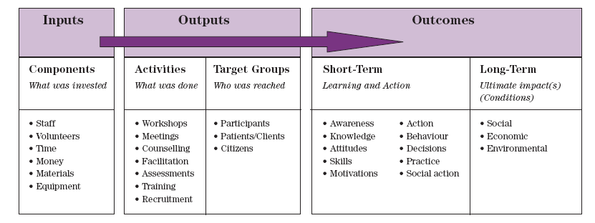
Development of a frame logical model
A program logic model provides a framework for an evaluation. It is a flow chart that shows the program’s components, the relationships between components and the sequencing of events.

Slide 33
Gathering of Qualitative and Quantitative Information: Instruments
Qualitative tools:
There are five frequently used data collection processes in qualitative evaluation (more than one method can be used):
1. Unobtrusive seeing, involving an observer who is not seen by those who are observed;
2. Participant observation, involving an observer who does not take part in an activity but is seen by the activity’s participants.
3. Interviewing, involving a more active role for the evaluator because she /he poses questions to the respondent, usually on a one-on-one basis
4. Group-based data collection processes such as focus groups; and
5. Content analysis, which involves reviewing documents and transcripts to identify patterns within the material

Slide 34
Quantitative tools:
“Quantitative, or numeric information, is obtained from various databases and can be expressed using statistics.”
  Surveys/questionnaires;
  Registries
  Activity logs;
  Administrative records;
  Patient/client charts;
  Registration forms;
  Case studies;
  Attendance sheets.

Slide 35
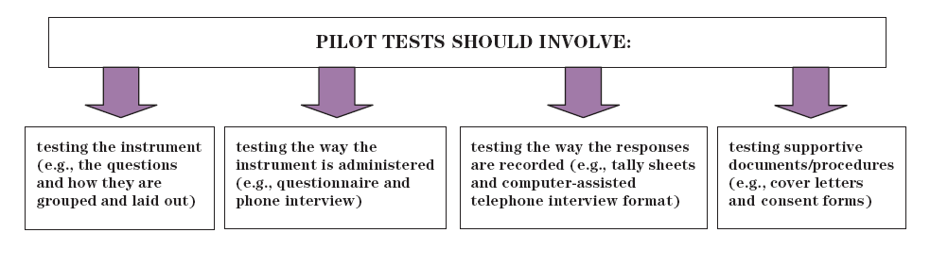
Pretesting or piloting......

Slide 36
Other monitoring and evaluation methods:
Biophysical measurements
Cost-benefit analysis
Sketch mapping
GIS mapping
Transects
Seasonal calendars
Most significant change method
Impact flow diagram ( cause-effect diagram)
Institutional linkage diagram (Venn/Chapati diagram)
Problem and objectives tree
Systems (inputs-outputs) diagram
Monitoring and evaluation Wheel (spider web)

Slide 37
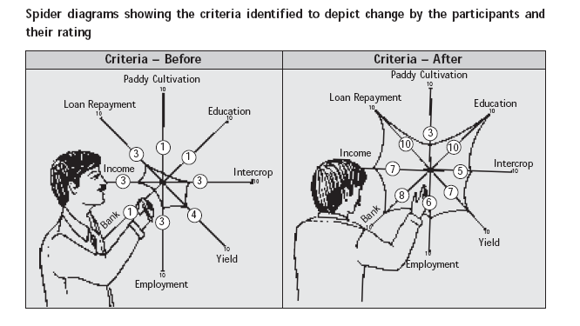
Spider Web Method:
This method is a visual index developed to identify the kind of indicators/criteria that can be used to monitor change over the program period. This would present a ‘before’ and ‘after’ program/project situation. It is commonly used in participatory evaluation.

Slide 38
Phase D: Reporting Findings
Write the evaluation report.
Decide on the method of sharing the evaluation results and on communication strategies.
Share the draft report with stakeholders and revise as needed to be followed by follow up.
Disseminate evaluation report.

Slide 39
Phase E:Implementing Evaluation
Recommendations
Develop a new/revised implementation plan in partnership with stakeholders.
Monitor the implementation of evaluation recommendations and report regularly on the implementation progress.
Plan the next evaluation

Slide 40
References
WHO: UNFPA. Programme Manager’s Planning Monitoring & Evaluation Toolkit. Division for oversight services, August 2004,
Ontario Ministry of Health and Long-Term Care, Public Health Branch In: The Health Communication Unit at the Centre for Health Promotion. Introduction to evaluation health promotion programs. November 23, 24, 2007.
Donaldson SI, Gooler LE, Scriven M. (2002). Strategies for managing evaluation anxiety: Toward a psychology of program evaluation. American Journal of Evaluation. 23(3), 261-272.
CIDA. “CIDA Evaluation Guide”, Performance Review Branch, 2000.
OECD. “Improving Evaluation Practices: Best Practice Guidelines for Evaluation and Background Paper”, 1999.
UNDP. “Results-Oriented Monitoring and Evaluation: A Handbook for Programme Managers”,
Office of Evaluation and Strategic Planning, New York, 1997.
UNICEF. “A UNICEF Guide for Monitoring and Evaluation: Making a Difference?”, Evaluation Office, New York, 1991.

Slide 41
References (cont.)
UNICEF. “Evaluation Reports Standards”, 2004.
USAID. “Performance Monitoring and Evaluation – TIPS # 3: Preparing an Evaluation Scope of
Work”, 1996 and “TIPS # 11: The Role of Evaluation in USAID”, 1997, Centre for Development Information and Evaluation. Available at http://www.dec.org/usaid_eval/#004
U.S. Centres for Disease Control and Prevention (CDC). “Framework for Program Evaluation in Public Health”, 1999. Available in English at http://www.cdc.gov/eval/over.htm
U.S. Department of Health and Human Services. Administration on Children, Youth, and Families (ACYF), “The Program Manager’s Guide to Evaluation”, 1997.

Slide 42
Thank You

